Slide 1
Test Automation

Slide 2
API Test Automation
What is Postman?
Create test cases in postman
Exercises
Continuous Integration/Continuous Deployment
Exercises

Slide 3
API Test Automation

Slide 4
API test automation
Request creation
Input request creation such as XML, json
Map test data and headers with input request
Request submission
Response
Read response and verify the content of the response
Submit request to API with methods such as get, post etc.,
Report results
Encrypt request if needed
Prior to creating automation framework, it is mandatory to understand what type of request project used such as Json, XML.
Enable framework to perform - assertions on response headers and content, handle arrays in request and response, chaining of API’s
API automation framework can be developed as data driven, keyword driven and service object model.
API automation framework should be interactable with other application frameworks and enterprise applications such as SCM, test management etc.,

Slide 5
API types
In nutshell - API’s are used when a software/application to communicate with other software/application. These software/application can be from same network/organization or different network/organization.
API communication/calls can be divided into 2 ways
Synchronous calls also called web service over HTTP such as SOAP and REST
Asynchronous calls also called Messaging service such as Java Message Service and MQ’s
With increasing in API use, development architecture has been evolved from Monolithic to Microservices. It is a method of breaking applications into loosely coupled modules/microservices.
UI
Microservices style is more organized with more focusing on business functionalities.
Microservices also reduces deployment complexities and also increases reusability.
UI
Microservice
Microservice
Business layer & API
Microservice
Microservice
Data layer
Data layer
Microservices

Slide 6
API testing
Benefits of API testing:
Early testing i.e. even before GUI availability
Covers Language-Independent and Platform-Independent scenarios
Cost Effective
Reduces GUI testing and increases execution speed
Similar to GUI testing, API testing also covers functional, integration, performance and security aspects.
Unlike GUI testing, API testing has standard below steps irrespective of the application.
Request creation
Request submission
Response validation
API is grey box testing and testers to understand the schema of the API request and response and requires some amount of technical knowledge
If a functionality can be accessed from API & GUI, then flow related scenarios should covered from GUI and API testing scope to be increased on the different calculations level.
If the application architecture is to present single functionality on multiple devices, then logical scenarios to be covered from API and flow related on Ui which can approx. 70% from API and 30% from UI.

Slide 7
API Testing - types
API Specification /Functional
API Security
Protocols, technologies and message formats (REST, SOAP, JMS, JSON), and industry-specific protocols (FIX, Swift, ISO 20022, ISO 8583)
Success Conditions - Response code, data format and schema
Error Conditions - Error messages with appropriate response code
Data Types
Authentication and Authorization for API access
Standards - OAuth, WS-Security, Kerberos, SSL, SAML
APIs against vulnerabilities
Parameter Fuzzing
Malicious Script Injection and content
Cross Site Scripting
Quotas and throttle limits
Unit Testing
API Performance
Policy/rule/assertions
Conditional flows and steps/assertions in the API configuration
Extension points implemented using JavaScript, Java or any other custom implementation
API configuration
Expected response time/ throughput, latency SLAs and Caching performance
Average Response Time for each API under individual and mixed API loads – 90th Percentile and worst case
Average latency of the API layer
Average and Peak throughput in Transactions per Second (TPS) across all APIs
Average throughput for each API
System Performance during load
CPU Utilization
Memory Utilization
API Integration
For each API endpoint, hypermedia and external services
Success and error scenarios for each API resource URI
Parameterize and chaining of API’s

Slide 8
















API test Automation - tools
Technology Stack
Commercial Tools
Open Source Tools
REST JSON
Ready! API
CA DevTest
Parasoft SOATest
HP UFT
IBM RIT
Worksoft
Certify
API / Services Layer
Tricentis
Tosca
HTTP
Master
REST-
assured
SOAP
Other
…
Ready UI Pro
API testing has wide range of open source & commercial tools for automation
Tosca and worksoft are next generation automation tools supports scriptless/no-coding API automation.
With open source tools - Batch execution and automation requires more technical skill compared to commercial tools
* Above list of tools are popular tools but not complete list

Slide 9
Automation strategy
Requirements
Review automation goals & Requirements
Analyze
Define automation scope. Analyze Application and its compatibility.
Deliverables:
Automation scope, Risk Log & Estimates
Design
Design automation framework and identify application components for automation
Deliverables:
Automation plan includes model, standards, type of suites.
Develop
Test & Sign off
Execution & Maint.
Automate test cases and perform unit testing
Deliverables:
Automated test suite
End to end testing of automated test cases and review of automation assets.
Automate/Update test cases based on new requirement, test and sign off the new/updated test cases
Deliverables:
Automation deliverables List
Deliverables:
Review, Results & Sign off
Deliverables: Automated test suite, Review and sign off
Milestone | Responsible | Accountable | Consulted | Informed
Automation requirements | AE | AA | BA, AL
Automation goals | AL | AA | BA,AE
Automation deliverables List | AA | AL | AE | BA
Automation estimates | AA | AL | AE
Automation manual test cases | T | AA | BA | AL, AE
Automation risks and define mitigations | AA | AL, T |  | BA, AE
Environment requirements | AA | T, AL |  | BA
Automation Plan | AA | T | AL, AE | BA
Automation | AE | AE | AL, AA | BA
Automation Suite Review and Sign off | AL | FPT, AE, T , BA |  | AA
Track progress & manage issues | AL | AA, T AE |  | BA
*AA – Automation architect, AL – Automation Lead, BA – Business Analyst, T - Tester, AE – Automation Engineer, FPT – Functional and project team

Slide 10
Service virtualization
Service virtualization is a method to emulate the behavior of API. This is needed when dependent API is not available if its response to be simulated with another solution. It also enables early testing.
Payment API
Messaging service
Bank service
Authentication service
Payment API
Messaging service
Service virtualization tool
Authentication service
Combination of API, DevOps and Agile usage is increasing hence need of service virtualization also increased.
Example:
In the above example, e-commerce has payment API contains 3 dependent third party API’s/services: (1. Authentication of card from service provider 2. Debit/credit transaction from bank 3. Send message to user). For successful payment API response, all these services should be available and working
Consider, There is a change planned in payment API which has impact on bank service. Both project team and third party team(bank) to update the code based on requirement. In any case if payment API changes are completed and bank service API deliverable is pending which causes roadblock to test payment API then in those cases service virtualization can be enabled to mimic new changes on Bank service API.
Service virtualization is the temporary solution in the development and testing phases.

Slide 11
What is Postman

Slide 12

What is Postman?
A collaboration platform for API development by sending set of API collections within teams
An application for testing APIs, by sending request to the web server and getting the response back

Slide 13
Postman Features
You can simply test any API and see the response immediately.
You can create a collection of API endpoints and call them whenever you want to see the responses.
You can share these collections, when you are logged in with team members.
You can use Postman's CLI client, Newman, to write Postman tests with JavaScript.
You can write tests in JavaScript to test the response that comes when a Postman request is made.
Finally, once you have all these endpoints created, you can export a JSON file, both for the endpoint tests and the environment variables, which again can be used by Postman as a source of for the tests.

Slide 14
Postman Collections
Collection folders make it easy to keep your API requests and elements organized
Generate Collections from API schemas
Easily Share Your Collections
Create beautiful, machine readable API documentation from your collections

Slide 15
Exercise 1 – a. Install postman
Download Postman application on the official website by choosing the suitable version
https://www.postman.com/downloads/

Slide 16
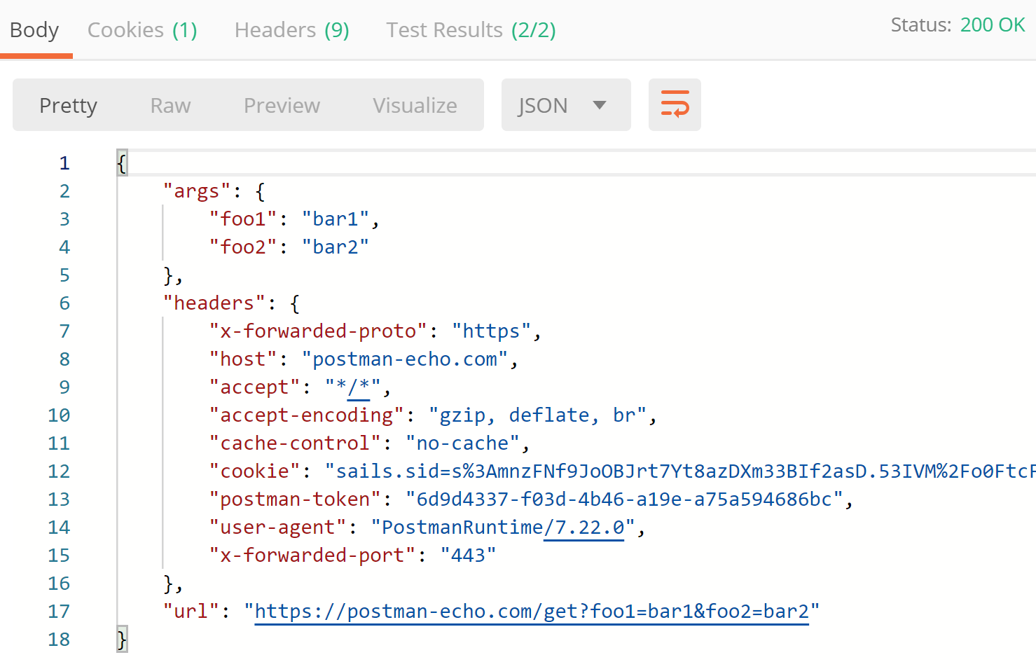
Exercise 1 - Test an sample API
Go to https://docs.postman-echo.com/?version=latest and click Run in Postman
Import the collection and access the folder “Request Methods”
Open “GET request” and send the request
The response should return status 200

Slide 17
Create Test Cases in Postman

Slide 18
Create test cases in Postman
Test scripts are run after a request is sent and a response has been received from the server. We write test cases to validate response data, response times, analyze the responses sent by the API, create integration test suites and integrate with build systems.
Example functions:
Set global and environment variables
Check response string
Check response status code
Check specific JSON value
https://learning.postman.com/docs/postman/scripts/test-examples/
http://blog.51cto.com/luchunli/1711309

Slide 19
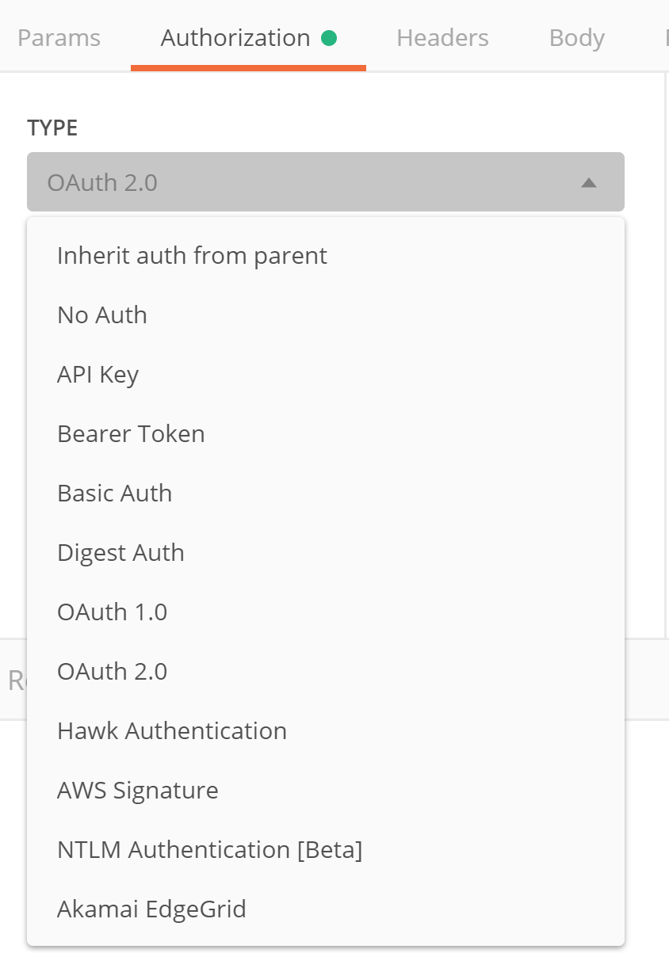
Add authentication
Setup authentication for API call
APIs use authorization to ensure that client requests access data securely
Example types of authentication supported in Postman:
Basic Auth (username + password)
API Key (key + value)
Bearer token (JSON Web Token)

Slide 20
Global variable and environment variable
Setup global variable for the test scripts
Setting an environment variable
pm.environment.set("variable_key", "variable_value");
Setting a global variable
pm.globals.set("variable_key", "variable_value");
Getting a variable value
var value = pm.variables.get("variable_key");

Slide 21
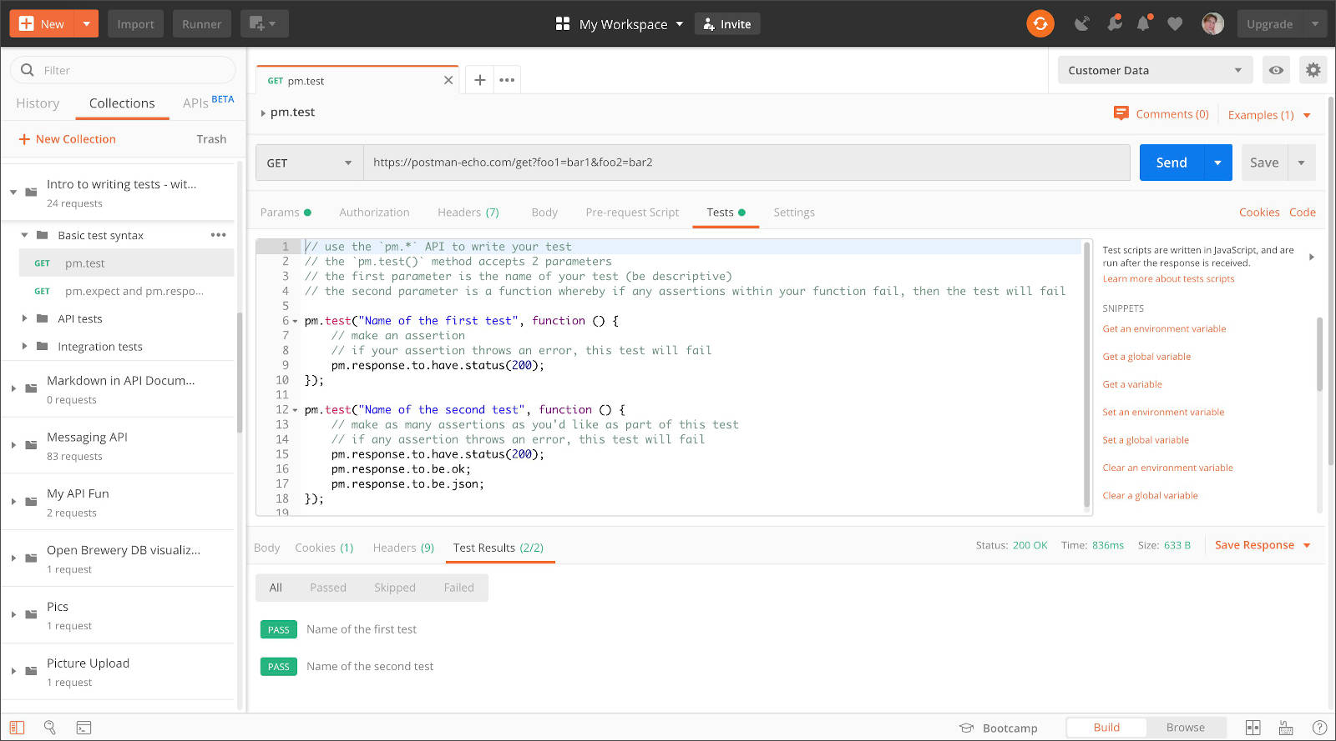
Javascript
We can write test scripts for your Postman API requests in JavaScript. Tests allow you to ensure that your API is working as expected, to establish that integrations between services are functioning reliably, and to verify that new developments haven't broken any existing functionality.

Slide 22
Exercise 2 - Create test cases and collection
Parameterize Requests
Instead of creating the same requests with different data, you can use variables with parameters. These data can be from a data file or an environment variable. Parameterization helps to avoid repetition of the same tests and iterations can be used for automation testing.
Parameters are created through the use of double curly brackets: {{sample}}.

Slide 23
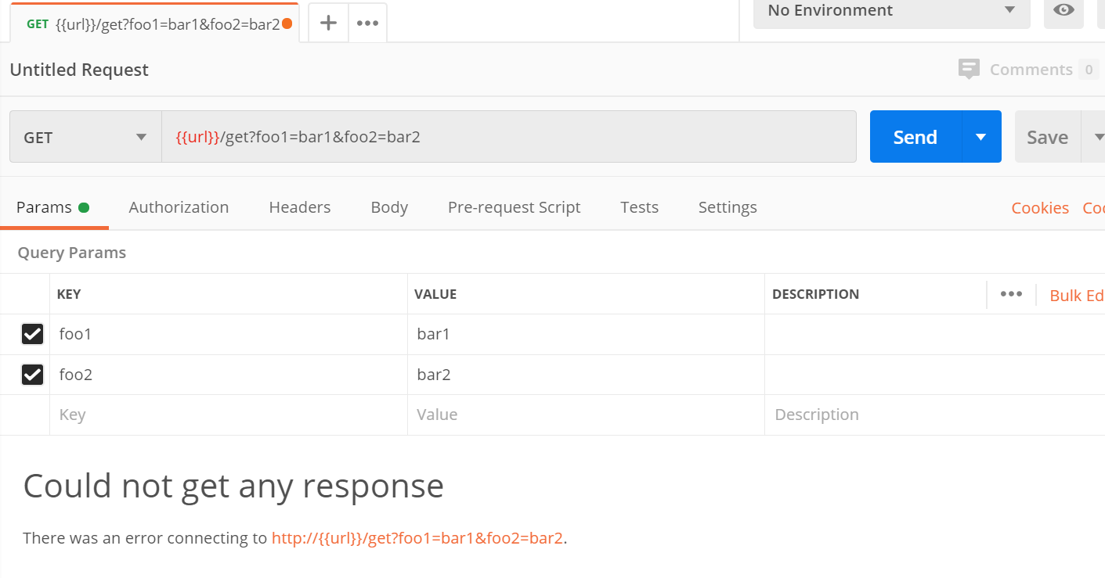
Exercise 2 - Create test cases and collection
Parameterize Requests
New a request tab in main panel
Set your HTTP request to GET
Input this link: https://postman-echo.com/get?foo1=bar1&foo2=bar2 Replace the first part of the link with a parameter such as {{url}}. Request url should now be {{url}}/get?foo1=bar1&foo2=bar2.
Click send.
“Could not get any response” result returned as {{url}} parameter is not defined.

Slide 24
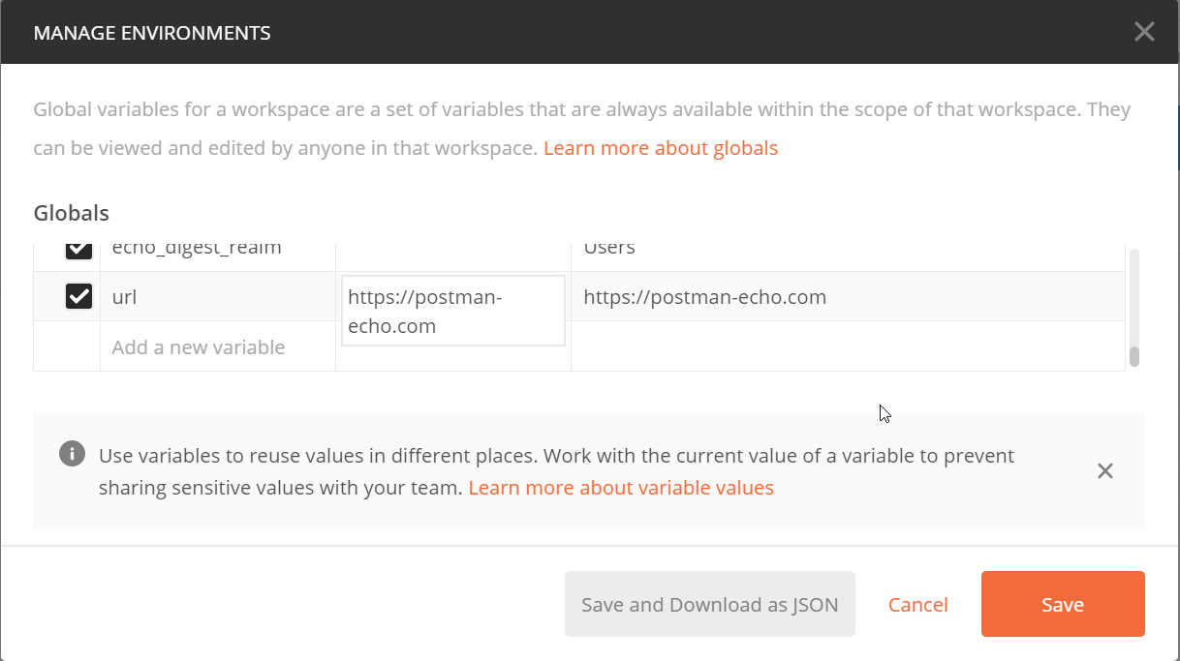
Exercise 2 - Create test cases and collection
Parameterize Requests
Click the “eye” icon
Click edit to set the variable to a global environment which can be used in all collections.
Add a new variable url and set the initial value to the url which is https://postman-echo.com
click Save.
Close the “Manage environments” window to skip create environment step.

Slide 25
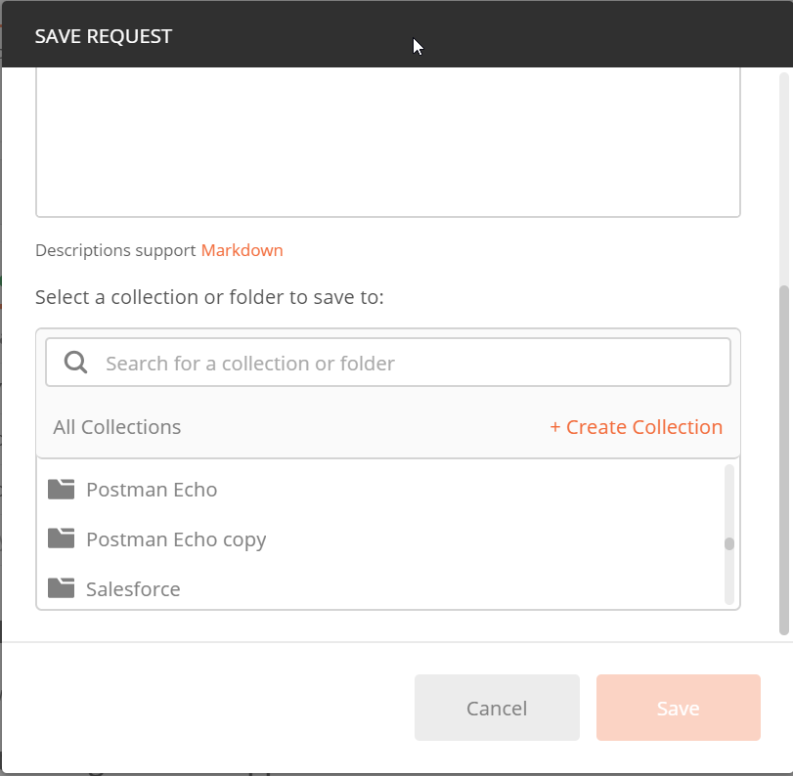
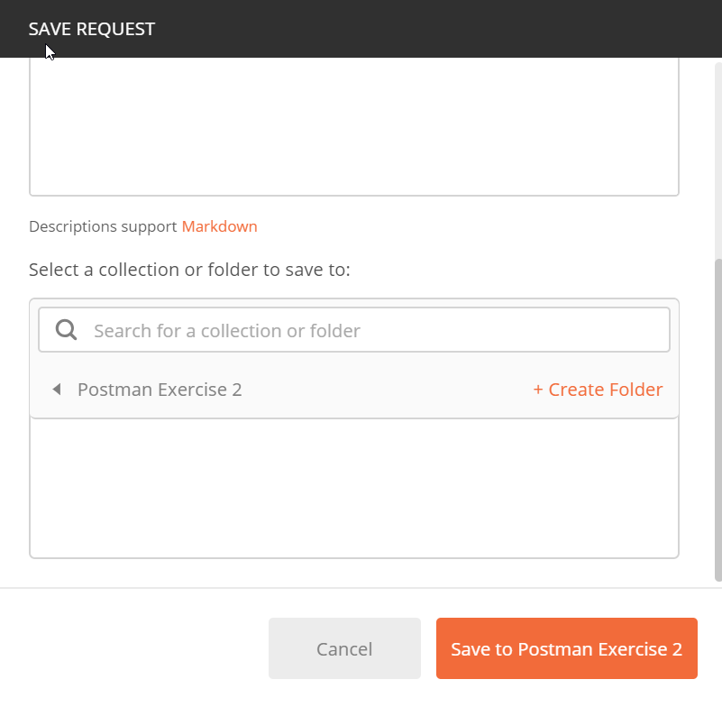
Exercise 2 - Create test cases and collection
Parameterize Requests
Select “Save as” option of the “Save” button
Click “+ Create Collection” to create a new collection with name “Postman Exercise 2”
Click “Save to Postman Exercise 2” button to save the request to the new collection

Slide 26
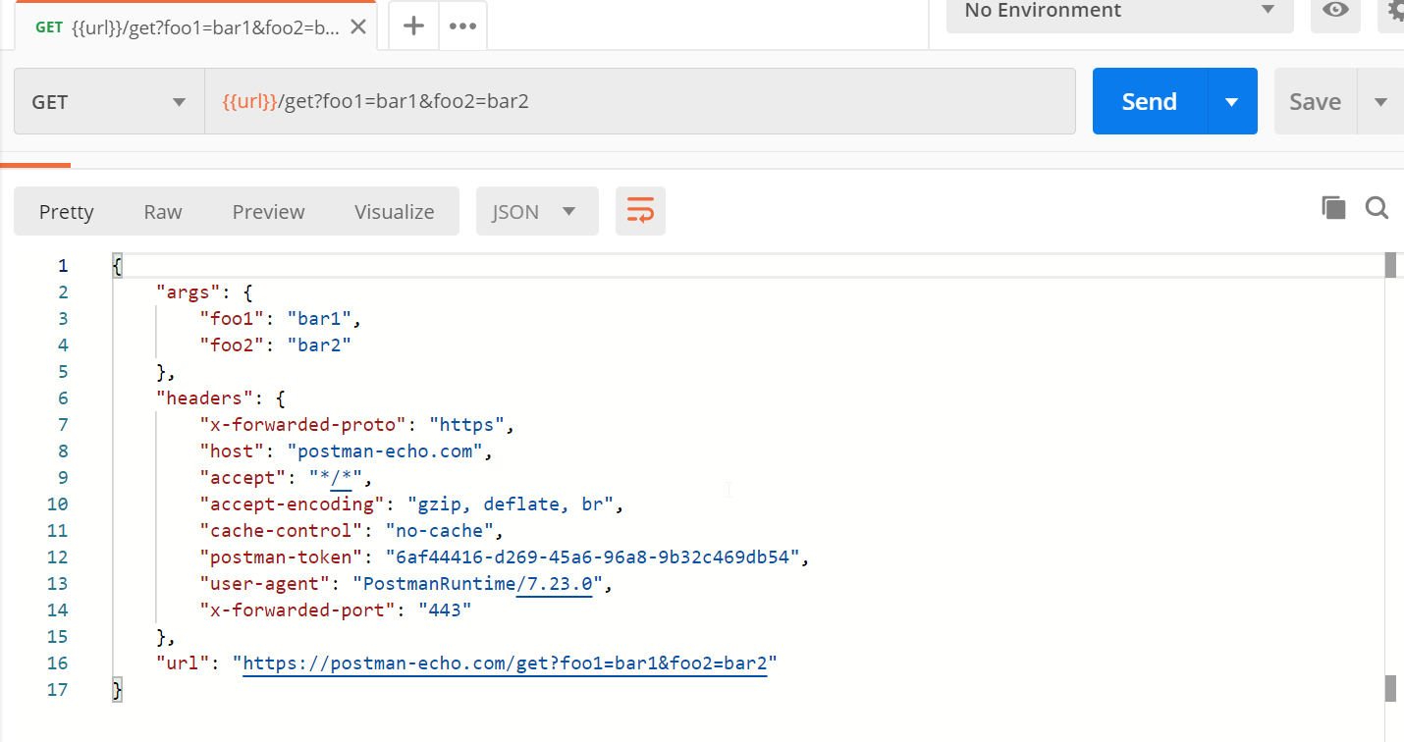
Exercise 2 - Create test cases and collection
Parameterize Requests
Click the “Send” button again and you should able get the response now.

Slide 27
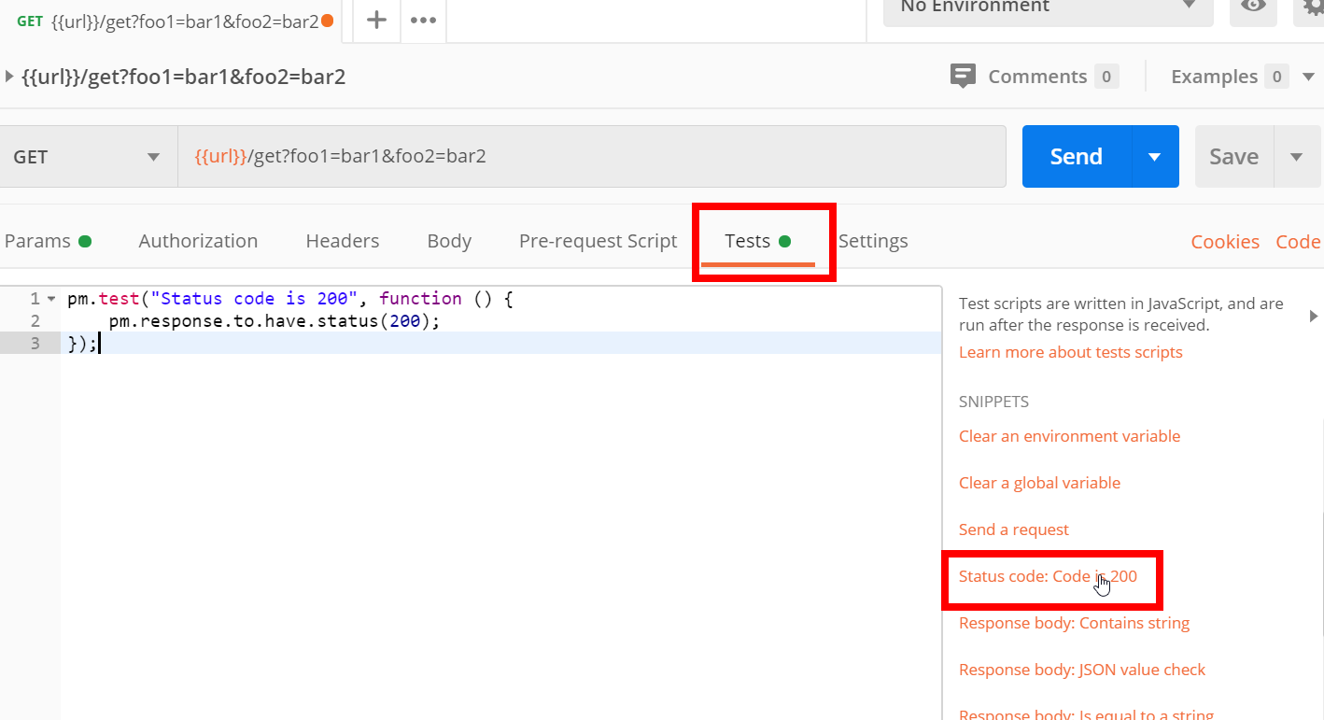
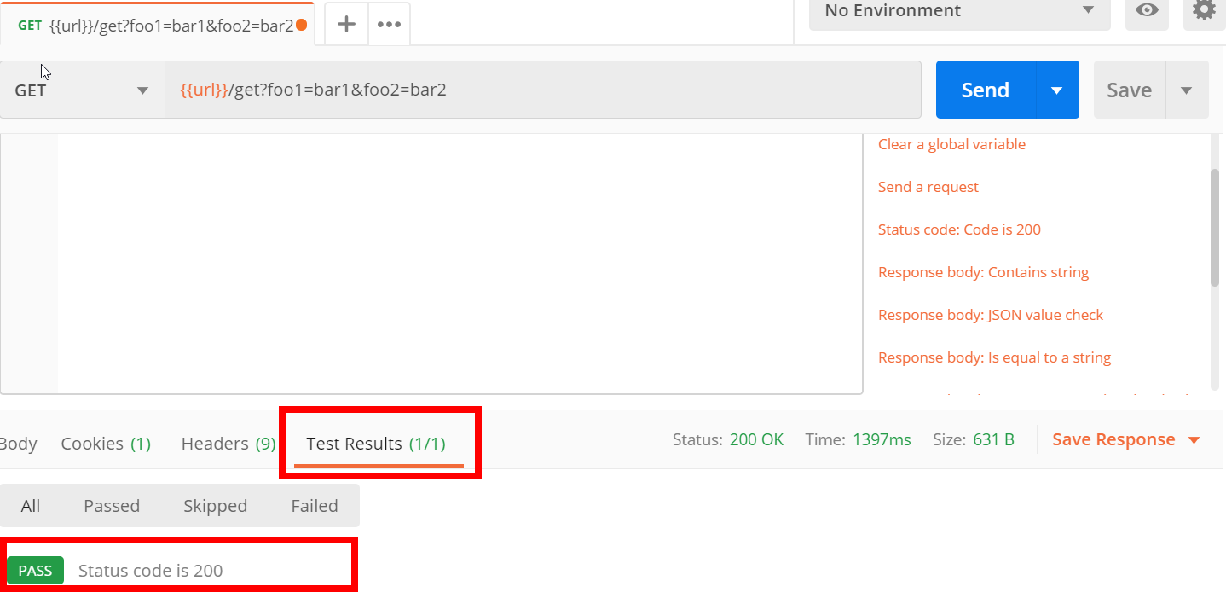
Exercise 2 - Create test cases and collection
Validate the response status
In the previous request, switch to tests tab.
From the snippets section, click on "Status code: Code is 200". It is a test script to test whether the API response http status 200. Usually, status 200 means API executed successfully.
Now click Send. The test result should now be displayed.

Slide 28
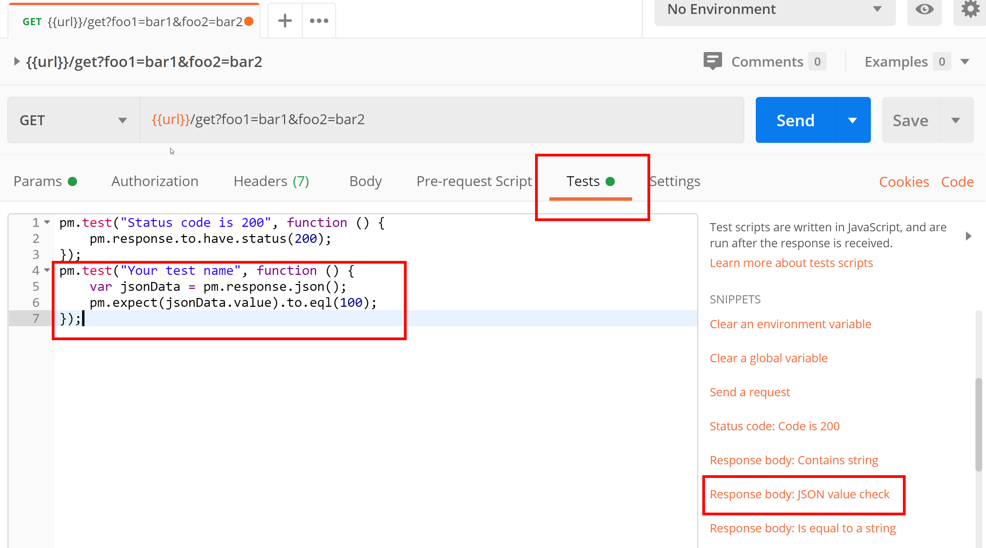
Exercise 2 - Create test cases and collection
Validate the response content
From the snippets section, click on "Response body:JSON value check". We will be checking if attribute foo1’s value is bar1 in the reponse.
"foo1": "bar1"

Slide 29
Exercise 2 - Create test cases and collection
Validate the response content
From the snippets section, click on "Response body:JSON value check". We will be checking if attribute foo1’s value is bar1 in the response.
"foo1": "bar1"

Slide 30
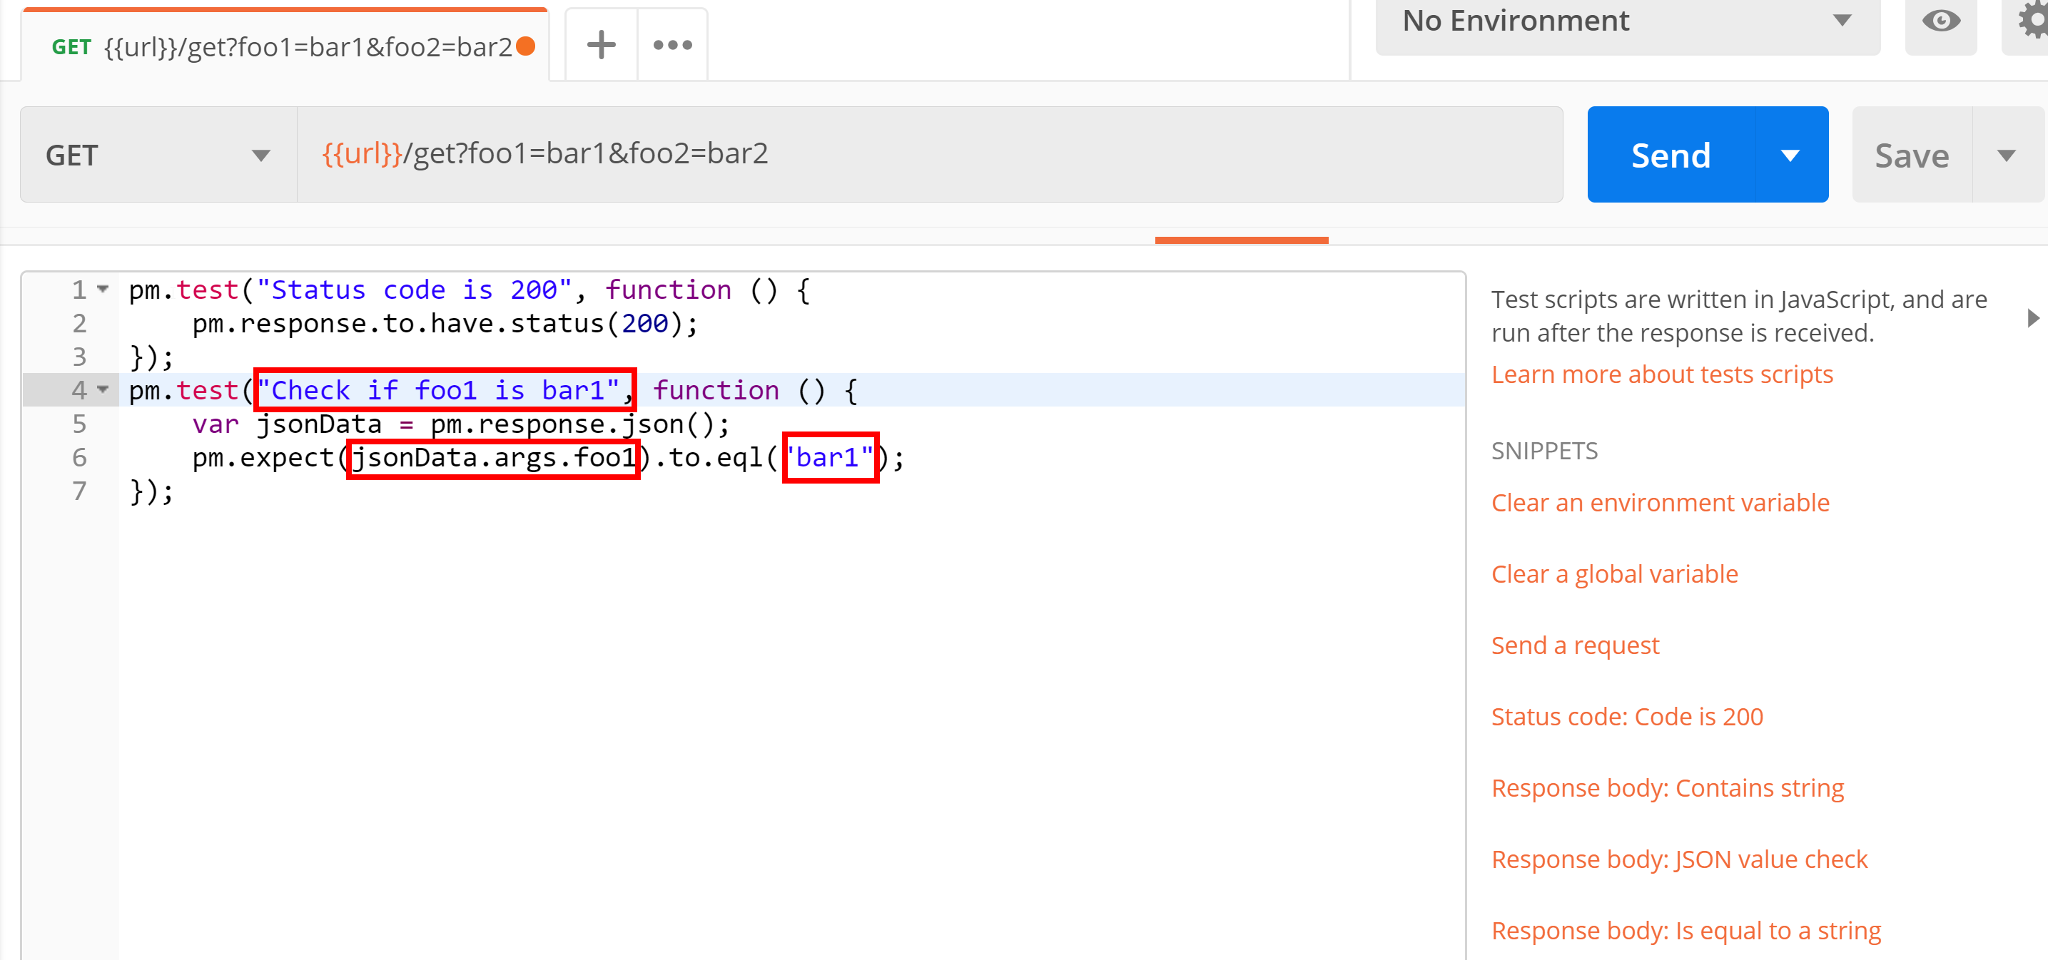
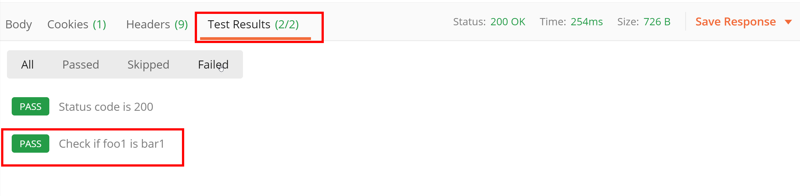
Exercise 2 - Create test cases and collection
Validate the response content
Replace “Your Test Name” from the code with “Check if foo1 is bar1” so that the test name specifies exactly what we want to test.
Replace jsonData.value with jsonData.args.foo1. To get the path, check the body in Get result earlier.
In to eql, input “bar1“
Click Send. This should now be two passed test results.

Slide 31
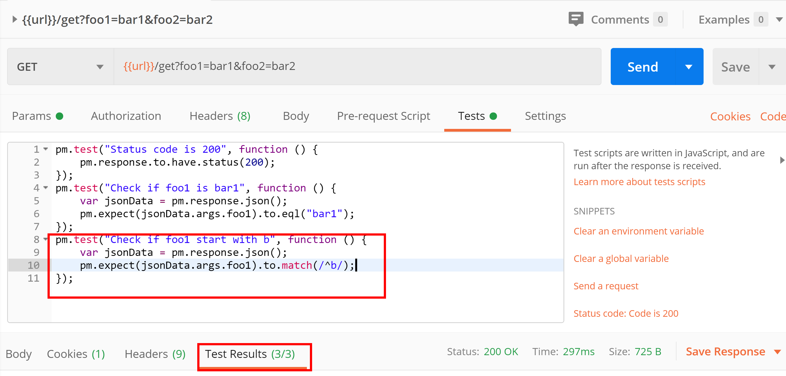
Exercise 2 - Create test cases and collection
Validate the response content with regular expression
Copy the previous test again as our 3rd test cases.
Change the test name to “Check if foo1 start with b”
Change the to.equal(“bar1”) to “to.match(/^b*)”
Click Send. This should now be two passed test results.
You can learn more regular expression from here https://www.w3schools.com/js/js_regexp.asp and https://www.regular-expressions.info/javascriptexample.html

Slide 32

Exercise 2 - Create test cases and collection
Run Collections using Collection Runner
Click on the Runner button found at the top of the page next to the Import button.

Slide 33
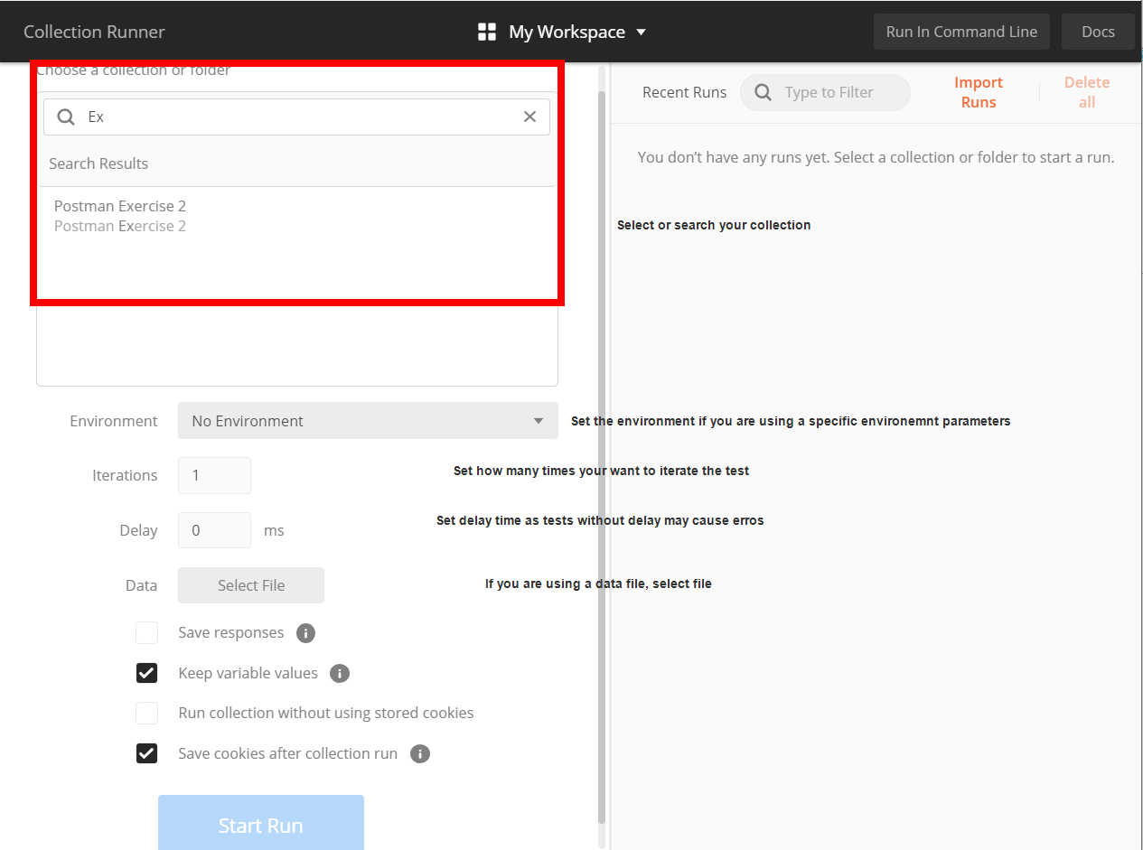
Exercise 2 - Create test cases and collection
Run Collections using Collection Runner
Collection Runner page should appear such as below. Following is the description of various fields

Slide 34
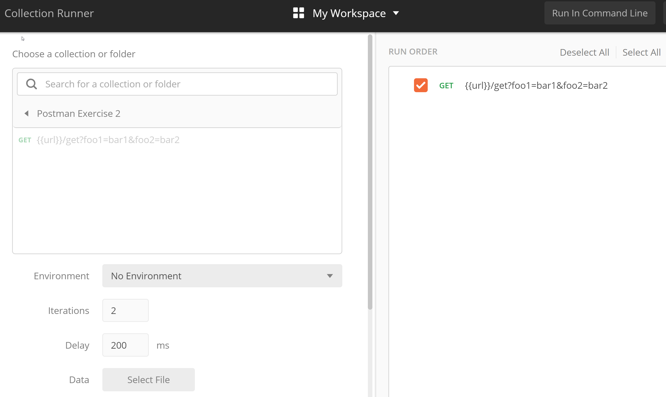
Exercise 2 - Create test cases and collection
Run Collections using Collection Runner
Select the collection we just created
Change Iterations to 2
Change Delay to 200ms
Click Run

Slide 35
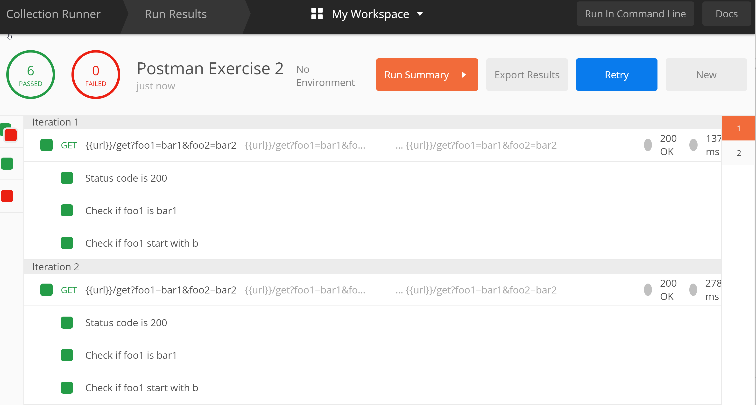
Exercise 2 - Create test cases and collection
Run Collections using Collection Runner
Check the execution results

Slide 36
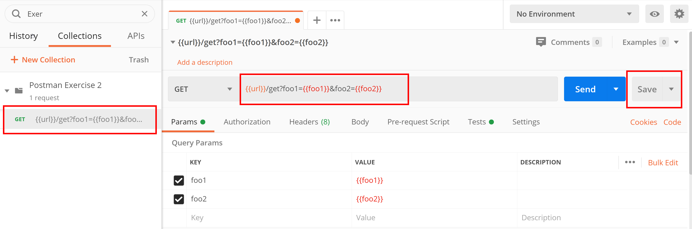
Exercise 2 - Create test cases and collection
Run Collections using Collection Runner with data file
Edit the request in the collection with request parameters.
Click on the request and edit the url with two parameters: foo1 and foo2
Click Save

Slide 37
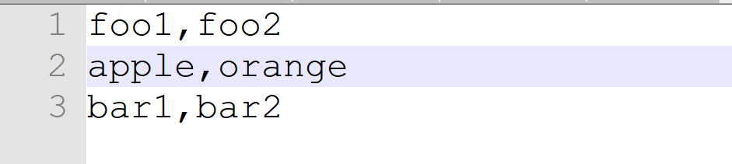
Exercise 2 - Create test cases and collection
Run Collections using Collection Runner with data file
Prepare a csv file with following rows
foo1,foo2
apple, orange
bar1,bar2
Save the data file to tdd-exercise2.csv

Slide 38
Exercise 2 - Create test cases and collection
Run Collections using Collection Runner with data file
Click on the Runner button found at the top of the page next to the Import button.

Slide 39
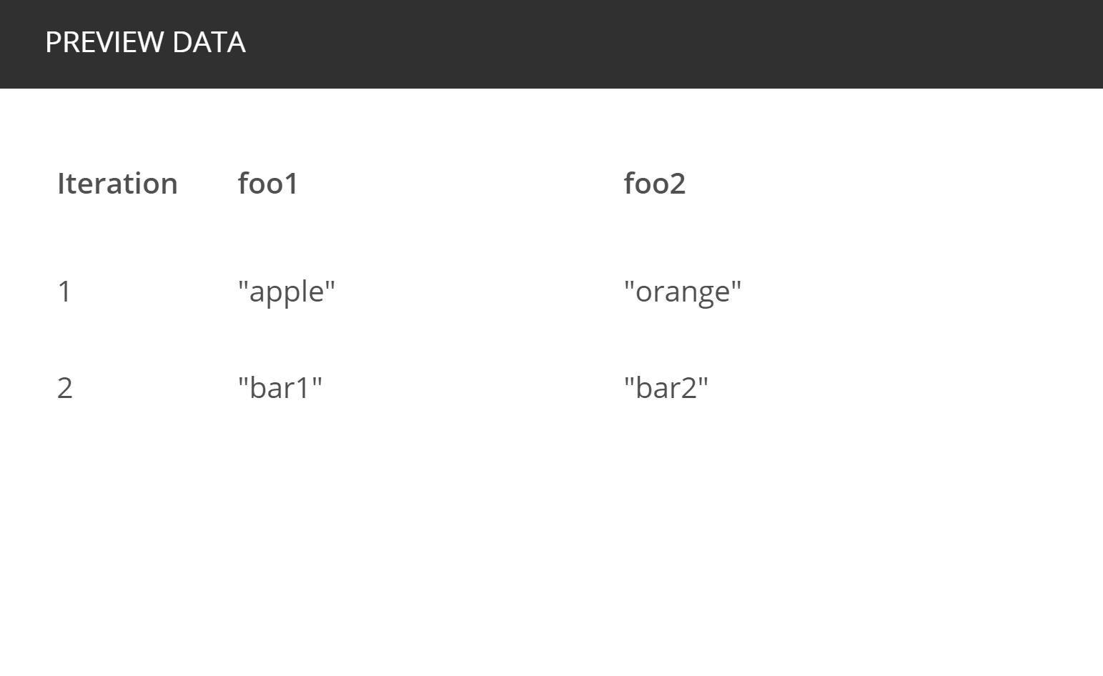
Exercise 2 - Create test cases and collection
Run Collections using Collection Runner with data file
Select the collection we just created
Change Iterations to 2
Change Delay to 200ms
Select the data file just created
Select the data file type to text/csv
Click Preview.
In the iteration 1, it will use apple as the foo1 value and orange as the foo2 value. In the iteration 2, it will use bar1 as the foo1 value and bar2 as the foo2 value.

Slide 40
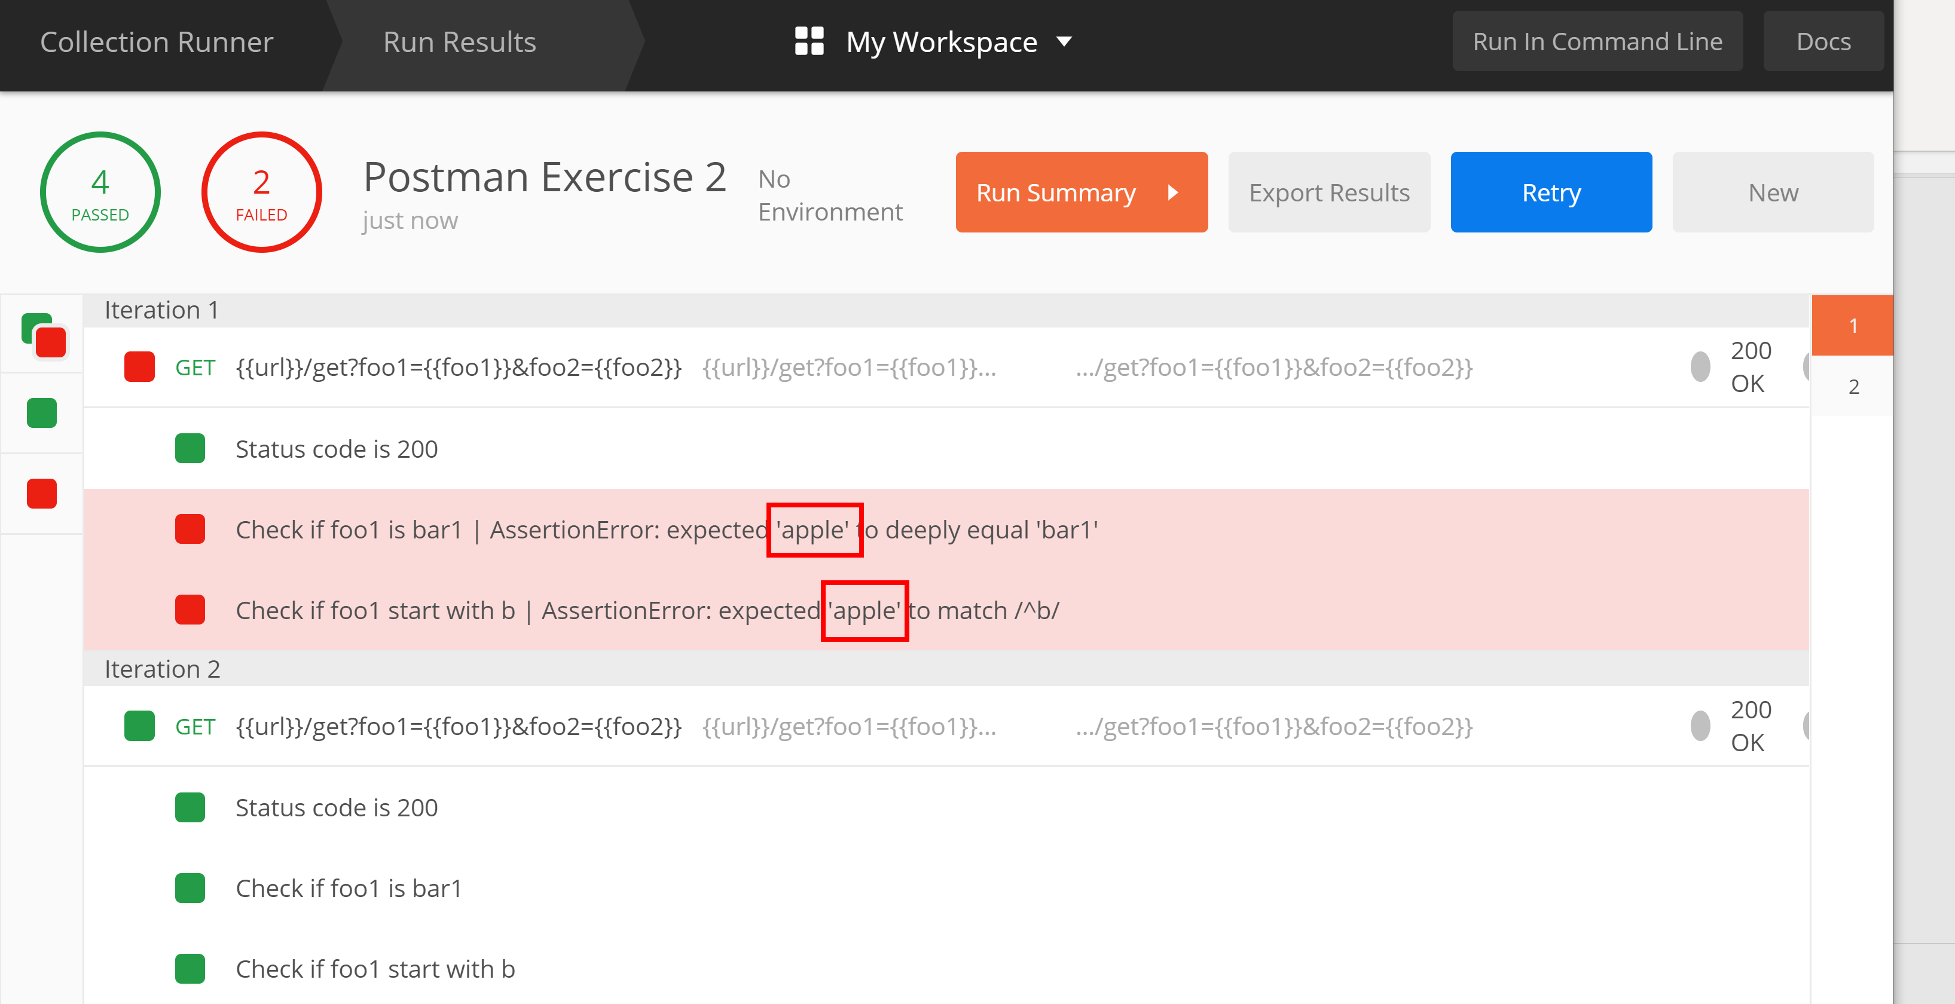
Exercise 2 - Create test cases and collection
Run Collections using Collection Runner with data file
Click Run and view the result. The first iteration test should be failure as it is not equal to bar1 and start with b

Slide 41
Continuous Integration/Continuous Deployment

Slide 42
DevOps - Continuous Testing
Continuous Testing
Continuous testing aims for continuous early feedback at each check point. This process brings testing closer to DevOPs process.
Continuous testing requires an automation tool which can :
performs distributed execution to cover parallel execution
supports creating and executing multiple automation suites.
Integrates with CI tools
Review results
Group test case to automation suite
Schedule/Execute the build
Configure regression suite to CI Tool
Framework update/Test case creation
API Automation - Continuous Testing & DevOPs
API test automation should consider creating multiple automation suites such as smoke and regression.
API test automation should consider service virtualization to perform early testing.
API test automation framework should consider integration of DevOps tools such as Jenkins.
API test automation should consider early testing

Slide 43
Summary
In this lesson, we covered
What is API Test Automation and what should be tested
How to use Postman to test the API
How to create collection, test cases in the Postman

Slide 44
Reference
https://scotch.io/tutorials/write-api-tests-with-postman-and-newman

